Slide 1
Searching for Gravitational Waves Using Convolutional Neural Network
Jo-Kuang Liao

Slide 2
Overview
Background
and Theory
Gravitational waves
LIGO detector and searches
Convolutional neural network
Method
Noise simulation
Waveform simulation
Detection and parameter estimation CNNs
Results and Future Work
Detection results
Parameter estimation results
Future work

Slide 3
Gravitational Waves (GWs)
What are GWs
Ripples of spacetime
Generated by massive accelerating objects such as compact binary merger of black holes or neutron stars
Why GWs matter
Propagate at the speed of light and not easily changed by interactions with matter
Excellent probes for events that cannot be observed by EM radiations
Why GWs are difficult to detect
Extremely small amplitude ~ 10^20
High instrumental sensitivity and strong analytical capability are needed

Slide 4
LIGO Detector and Searches
Notes:
A gravitational wave detector is a large scale Interferometer consisting of two orthogonal arms in an L shape
Passing gravitational waves will alternately stretch and squeeze the arms, thus changing the travel time of laser beams and shifting the phase alignment.
This phase difference measures the change in the arm length, therefore the gravitational wave strain.
The analytical search for gravitational wave candidates is achieved by both generic transient search and binary coalescence search
Generic transient search identifies potential gravitational wave signals by looking for coincident bursts of excees power in multiple detectors, almost in real time.
Binary coalescence search targets gravitational waves emitted by compact binary mergers using waveform modelling, in order to attain more confident measurements and more accurate parameter estimation.
This method employs the matched filtering technique to compare gravitational wave strain data with an extensive bank of theoretically predicted waveforms.

Slide 5
Convolutional Neural Network
Notes:
A neural network consists of multiple layers.
A layer is made of multiple nodes.
Nodes in adjacent layers are connected to each other with the outputs of a layer becoming the inputs of the next one,
Hidden layers perform the functions of processing the data and transforming inputs to outputs.
Nodes are the points of computation
Weights signifies the importance of inputs for a specific task
Activation function determines the outputs from weighted inputs
A neural network learn and predict.
The learning refers to the process of finding the optimal weights to achieve the best performance for the task
The predicting process applies the weights learned from the prior training and produce an output accordingly.
Why

Slide 6
Method Overview
Data Generation
Data Analysis
1
2
Noise Simulation
Detection CNN
Detect GW events in noisy strain data
Training
Data
Strain Data Simulation
Waveform Simulation
Parameter Estimation CNN
Estimate chirp mass and luminosity distance
Notes:
Characterise the detector noise using its power spectrum and simulate noise with Gaussain distributions of frequencies
Simulate gravitational waveform using PyCBC by considering the component masses and luminosity distance
Inject gravitational waveform into noise to simulate strain data detected
Generate large data sets for training the CNNs
Construct and train the detection CNN and parameter estimation
Obtain models for detecting gravitational wave events in strain data and estimate the chirp mass and luminosity distance of the source

Slide 7
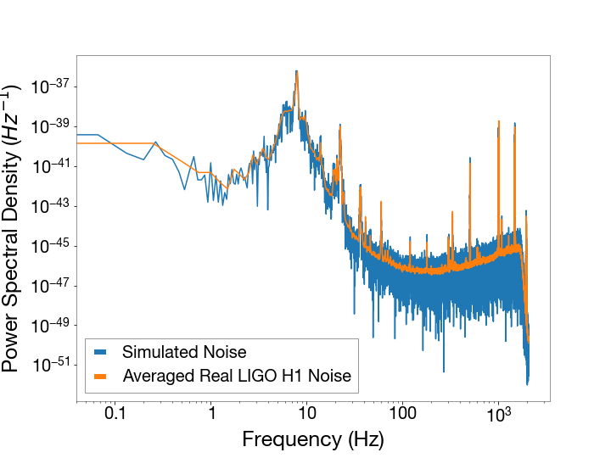
Noise Simulation
Sampling noise
Charactersing noise
Generating noise
Processing noise
Real noise was sampled around the 11 events in O1/O2
The power spectral density of real noise was computed
Noise was generated using Gaussian distributions
Noise was bandpassed and transformed to time series

Slide 8
Waveform Simulation
Identifying key parameters
Primary mass, secondary mass, luminosity distance
Generating wavefrom
Waveform was generated using PyCBC
Completing waveform
A sine wave was added prior to the waveform
Injecting wave into noise
Embedding wave into noise to simulate strain data

Slide 9
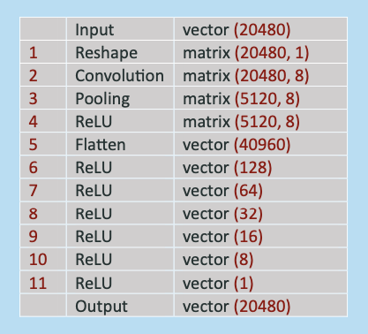
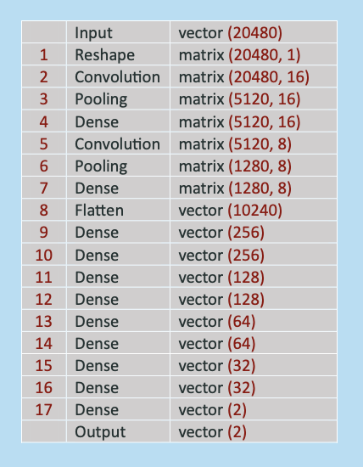
Detection and Parameter Estimation Neural Network
Detection
Parameter Estimation
Generating Training Data
10000 training data with or without GW
10000 training data with varying masses and distance
Building CNNs
Training CNNs
Supervised learning over 30 epochs
Evaluating Results

Slide 10
Detection Results
98%
overall accuracy
100%
accuracy for samples with SNR>1
100%
accuracy on detecting real GW events
97.45%
accuracy for samples with SNR<1
GW
No GW
Detected
48.9%
0.4%
Not
Detected
1.4%
49.3%
The detector CNN achieved high overall accuracy and can detect GW signals with low SNR
It has also been verified with the 11 GW events in LIGO O1 and O2

Slide 11
Parameter Estimation Results
Chirp Mass Estimation
Luminosity Distance Estimation
Chirp mass range: 8.7 – 87 solar mass
Average percentage error: 13.9%
Luminosity distance range: 10 - 1000 Mpc
Average percentage error: 16.7%
The parameter estimation CNN can predict both chirp mass and luminosity distance with moderate percentage error

Slide 12
Future Work

Slide 13
Summary

